Slide 1

MAHARASTRA STATE BOARD OF TECHNICAL EDUCATION
GOVERNMENT POLYTECHNIC, JINTUR
Department of Computer Engineering
Project Title:
"KRUSHI MITRA APP“
(Your Digital Partner in Farming)

Slide 2
KRUSHI MITRA:A SMART AGRICULTURE APP
Empowering Farmers With Real-Time data
A Final Year Project by
Onkar Narsing Dhembare CO302
Ganesh Bhanudas Rengade CO339
Aditya Balaji Suryawansh CO348
Krishna Kadaji Takalkar CO449

Slide 3
INTRODUCTION
Agriculture is India’s Backbone: Agriculture is the primary source of livelihood for about 58% of India’s population.
Current Challenges: Farmers face uncertainty due to unpredictable
weather and sudden market price fluctuations.
Information Gap: Lack of real-time information prevents farmers from
making profitable decisions.
Krushi Mitra - The Solution: This app aims to empower farmers by
providing real-time data and digital tools at their fingertips.

Slide 4
PROBLEM STATEMENT
Market Price Uncertainty: Farmers lack access to real-time Mandi rates, leading to financial losses while selling to middlemen.
Weather Vulnerability: Unpredictable weather changes and lack of local alerts often result in heavy crop damage.
Delayed Disease Diagnosis: Difficulty in identifying crop pests and finding the right fertilizers leads to reduced yields.
Information Accessibility: Existing agricultural data is scattered and too complex for an average farmer to use effectively.

Slide 5
OBJECTIVES OF THE PROJECT
Real-time Accessibility: To provide farmers with instant access to market and weather data.
Accuracy: To ensure the information (Market rates) is fetched from reliable government sources.
Ease of Use: To design a simple UI that even a non-technical person can operate easily.
Digital Empowerment: To reduce the dependency of farmers on middlemen for basic information.

Slide 6
TECHNOLOGY STACK
Component | Technology Used | Purpose
Frontend | Flutter (Dart) / HTML, CSS | Responsive & Modern UI
Backend Data | REST APIs (OpenWeather, Agri-Market) | Live Weather & Market Updates
Development | Capacitor Framework / VS Code | Hybrid App Development
Data Format | JSON Parsing | Handling Real-time Data

Slide 7
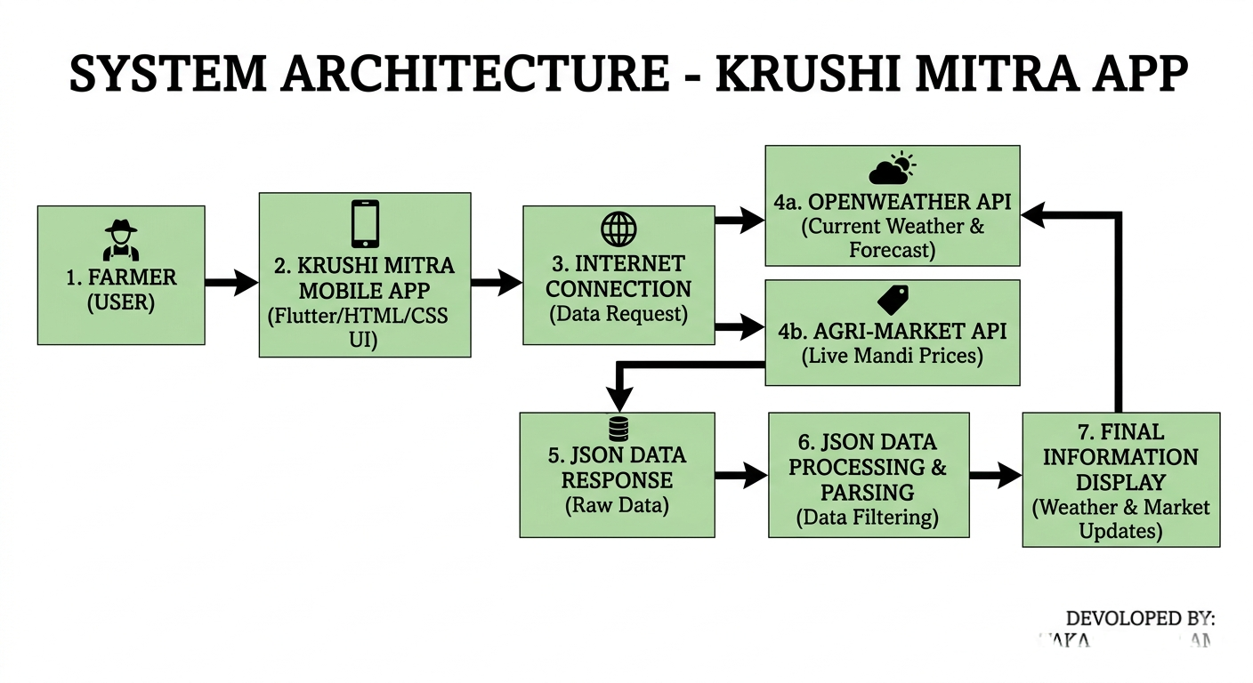
SYSTEM ARCHITECTURE

Slide 8
METHODOLOGY / WORKFLOW
Step 1: Data Collection: The app connects to the internet and requests data from REST APIs.
Step 2: Processing: The fetched JSON data is parsed and filtered based on the user's selected district.
Step 3: User Interface: The processed information is displayed on the Flutter-based dashboard.
Step 4: Interaction: The user can navigate through different sections like Weather, Market Prices, and Crop Info.

Slide 9
KEY FEATURES OF KRUSHI MITRA
Real-time Weather Forecast: Provides current temperature, humidity, and rainfall alerts using OpenWeather API.
Live Market Prices: Displays current market rates for various crops from different Maharashtra districts (APMC markets).
Smart Crop Suggestions: Basic guidance on which crops are suitable based on the current season.
User-Friendly Dashboard: A simple, icon-based interface designed specifically for easy navigation by farmers.
Multilingual Support: Potential to support local languages like Marathi for better accessibility.

Slide 10
AGRICULTURAL INFORMATION HUB
Government Schemes : Detailed insights into central and state government schemes like PM-Kisan, Pik Vima (Crop Insurance), and various solar pump subsidies.
Fertilizer & Pesticide Rates: Provides the latest market price lists for essential fertilizers (Urea, DAP, Potash) and pesticides to ensure farmers buy at the correct MRP.
Modern Agricultural Equipment: Information on high-tech machinery like tractors, rotavators, and sprayers, including details on how to apply for government subsidies for these tools.
Fair Trade Awareness: Empowers farmers with knowledge of actual market costs, reducing the risk of being overcharged by local retailers or middlemen.

Slide 11
CROP PROTECTION & MANAGEMENT
Disease Identification: Helps farmers identify common crop diseases like Blight or Rust by their symptoms.
Effective Solutions: Suggests the right pesticides, fertilizers, and organic treatments for quick crop recovery.
Preventive Tips: Provides guidance on how to protect crops from future pest attacks and improve soil health.
Expert Advice: Includes agricultural helpline numbers and expert tips for better crop management.

Slide 12
FUTURE SCOPE
IoT Integration: Connecting smart sensors for automated irrigation control.
AI Crop Disease Detection: Adding a feature where farmers can scan a leaf photo to identify diseases.
Expert Consultation: A direct chat or call feature to connect farmers with agricultural experts.
E-Marketplace: Developing a platform for farmers to sell their products directly to customers.
Offline Mode: Enabling basic features to work without an internet connection in remote areas.

Slide 13
CONCLUSION
Smart Farming: 'Krushi Mitra' provides a simple digital platform for farmers to manage their crops effectively.
Real-time Access: The app successfully gives instant updates on Market Rates and Weather to reduce financial risks.
Problem Solver: It bridges the gap between farmers and essential information like Government Schemes and Disease Solutions.
Future Ready: This project is a strong foundation for adding advanced technologies like AI and IoT in the future.

Slide 14
THANK YOU !!

